Slide 1
Chapter 2 OSI Model & TCP/IP Protocol Suite
The OSI/RM
Layers in the OSI/RM
TCP/IP protocol suite
Addressing in TCP/IP
TCP/IP versions

Slide 2
2.1 The OSI/RM
An ISO standard
  Open System Interconnection/ Reference Model
  开放系统互连/参考模型
  Released in 1984
  Ensured greater compatibility and interoperability
  7 layers, each of which illustrates a particular network function
ISO is the organization, OSI is the model
OSI is not a protocol, but a conceptual model

Slide 3
OSI Model
Application
应用层
7
应用支持层
（软件）
Presentation
表示层
6
Session
会话层
5
Transport
传输层
4
Network
网络层
3
网络支持层
（软/硬件）
Data Link
数据链路层
2
Physical
物理层
1

Slide 4
Why Layered？
Advantages
  Reduces complexity
  Standardizes interfaces
  Facilitates modular engineering
  Ensures interoperable technology
  Accelerates evolution
  Simplifies teaching and learning
Disadvantages
  Strict layered architecture makes its software not so efficient.
…
N+1
N
N-1
…

Slide 5
The Features of Layering
Each layer concerns on its own details
Each layer provides a service to the layer above
Each layer communicates with its peer layer in another node through the use of a corresponding protocol

Slide 6
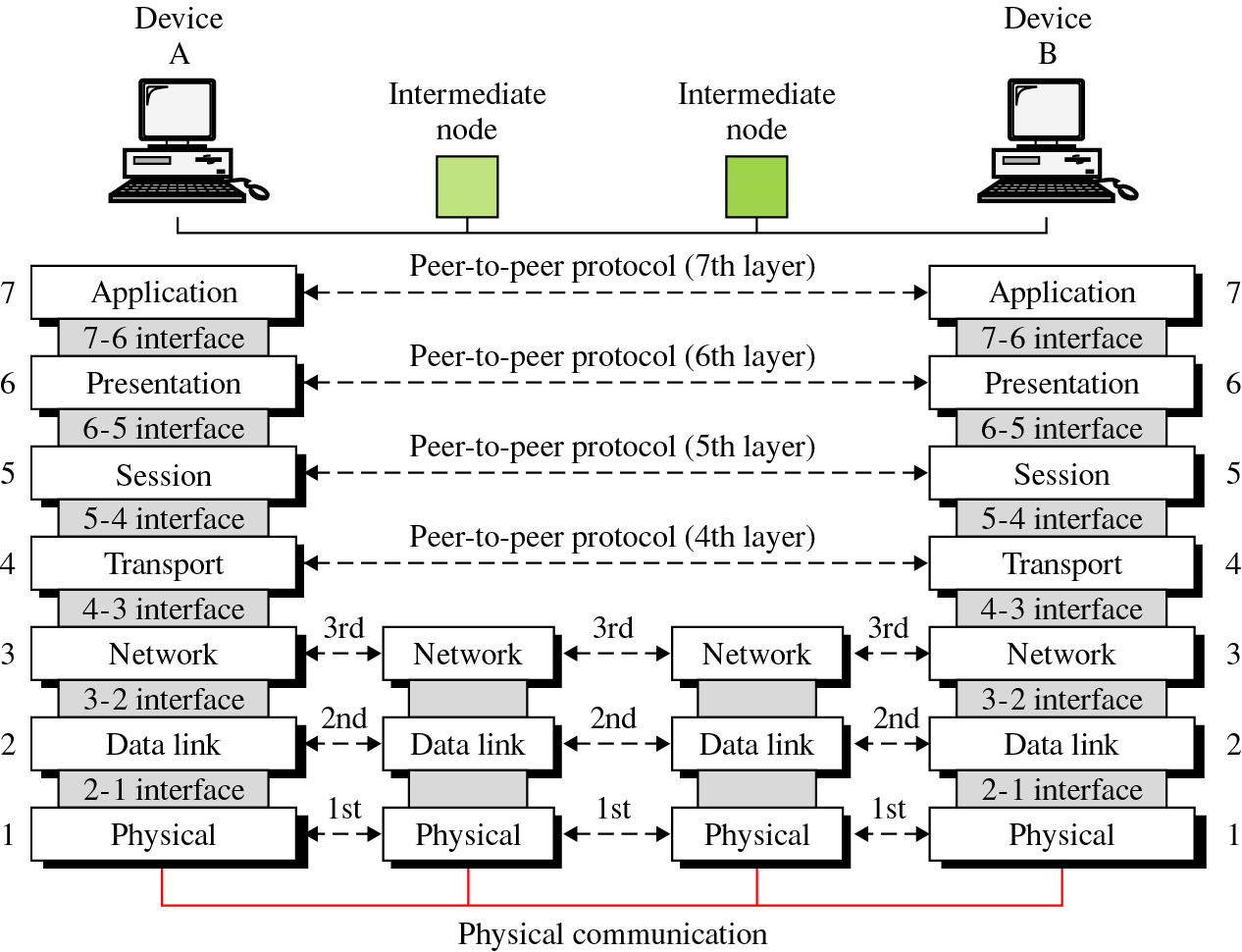
Peer-to-Peer Communication
对等进程/对等实体
（Peer Entity）
Peer Entity
对等进程/对等实体
对等层
Peer Layer
Peer Layer
对等层
Service
服务
Interface
接口
对等层协议
Peer-to-Peer Protocol
Peer-to-Peer Protocol
对等层协议

Slide 7
Peer Layer vs. Peer Entity
SMTP
HTTP
FTP
Layer 7
FTP Server
Layer 7
Outlook
FTP Server
Outlook
IE
IE
Mail Server
Mail Server
CutFTP
CutFTP
WWW Server
WWW Server
Multiple entities in one layer
  Peer entity：存在通信关系的对等层实体
Multiple protocols in one layer
  Protocol：对等实体间的通信规则

Slide 8
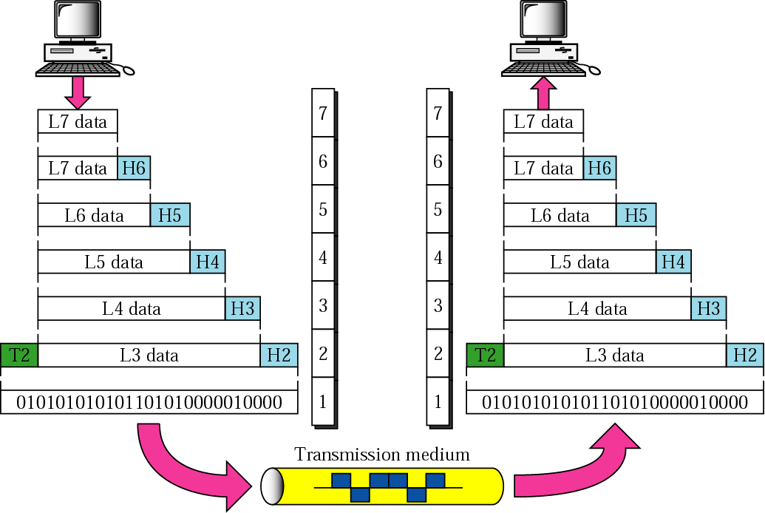
Data Exchange: Encapsulation
Source
Destination
A
数据 Data
PDU：Protocol Data Unit
协议数据单元
P
S
T
数据段 Segment
N
分组 Packet
DL
帧 Frame
Ph

Slide 9
Postal Delivery
信件格式
信件
信件
寄信方式
邮局
邮局
分拣邮包规则
分拣邮包
分拣邮包
邮路选择
邮政网络
邮政网络
运输方式
邮政运输
邮政运输
交通运输
同层间需要约定规则——协议

Slide 10
2.2 Layers in the OSI/RM
Application
Network processes to applications
7
Presentation
Data representation
6
Session
Inter-host communication
5
Transport
End-to-end connections
4
Network
Addressing and best path
3
Data Link
Access to media
2
Physical
Binary transmission
1

Slide 11
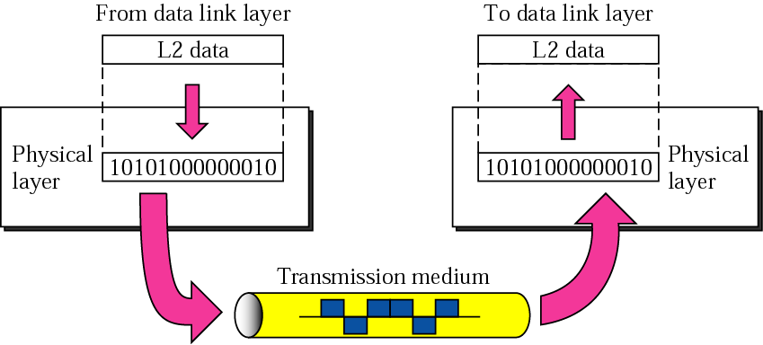
Physical Layer

Slide 12
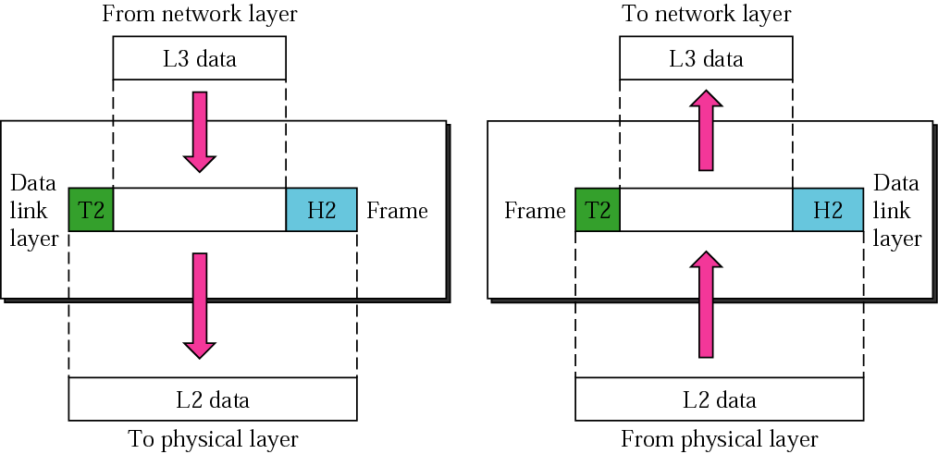
Date Link Layer

Slide 13
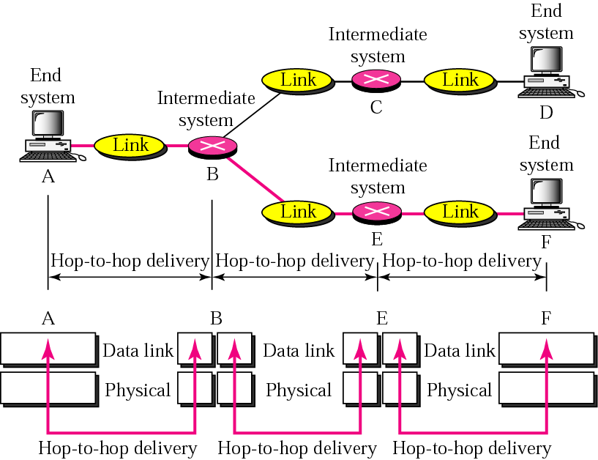
Point-to-Point Delivery

Slide 14
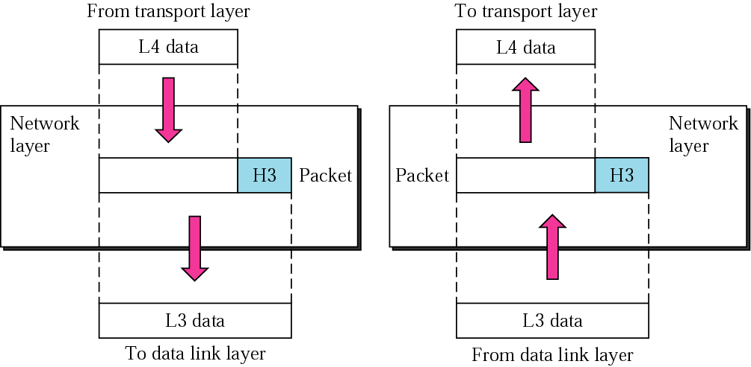
Network Layer

Slide 15
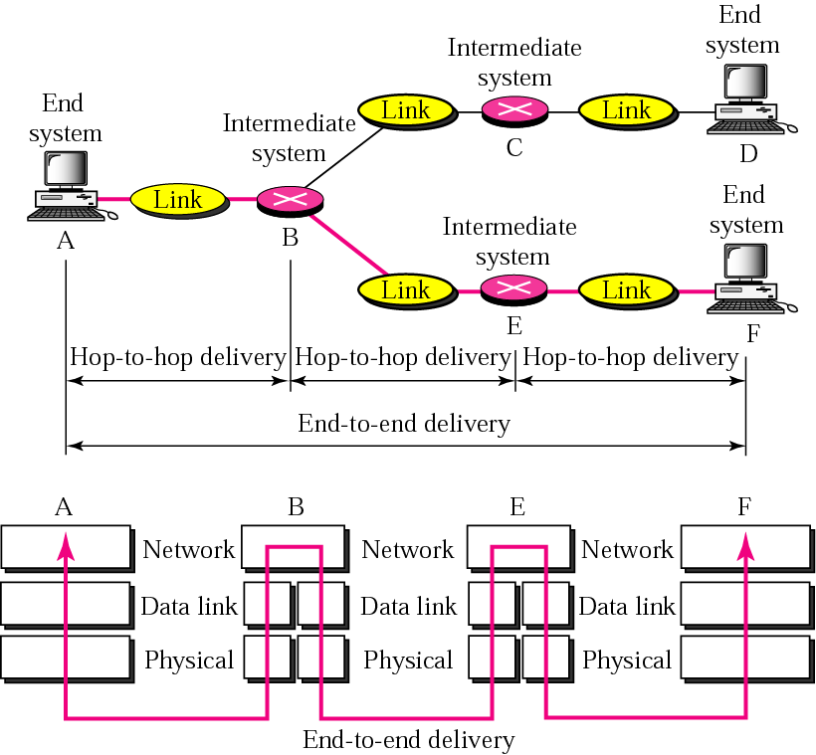
Host-to-Host Delivery

Slide 16
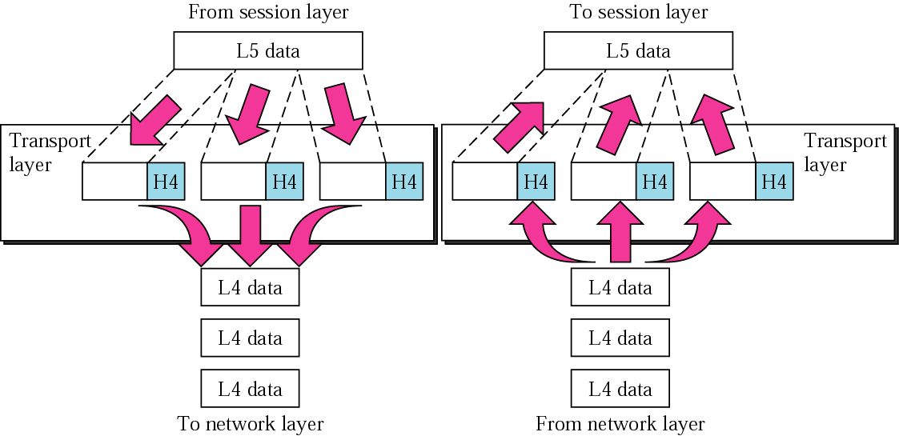
Transport Layer

Slide 17
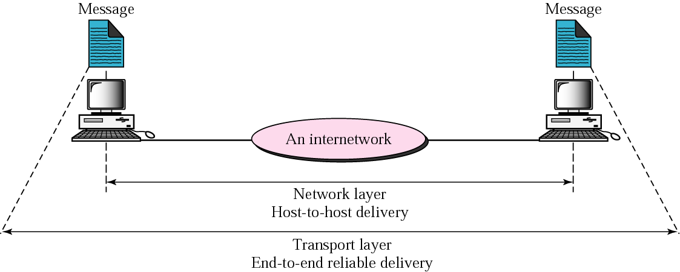
Reliable End-to-End Delivery of a Message

Slide 18
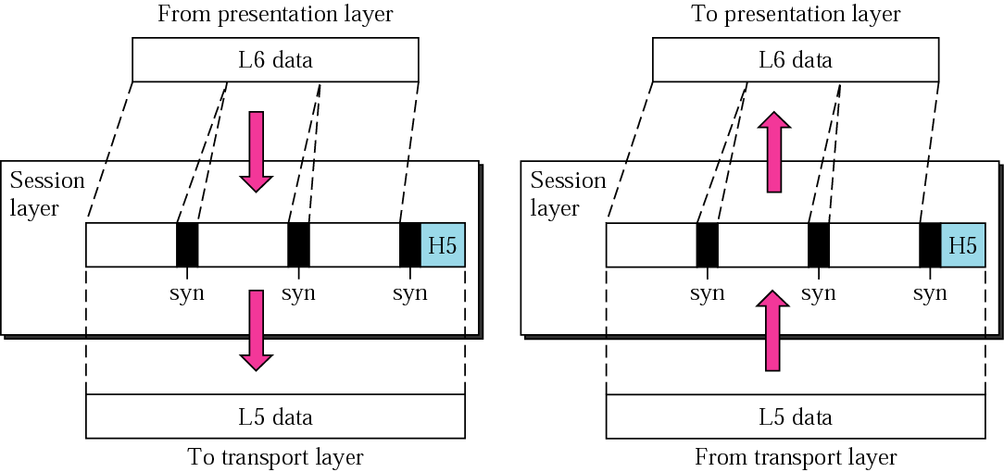
Session Layer

Slide 19
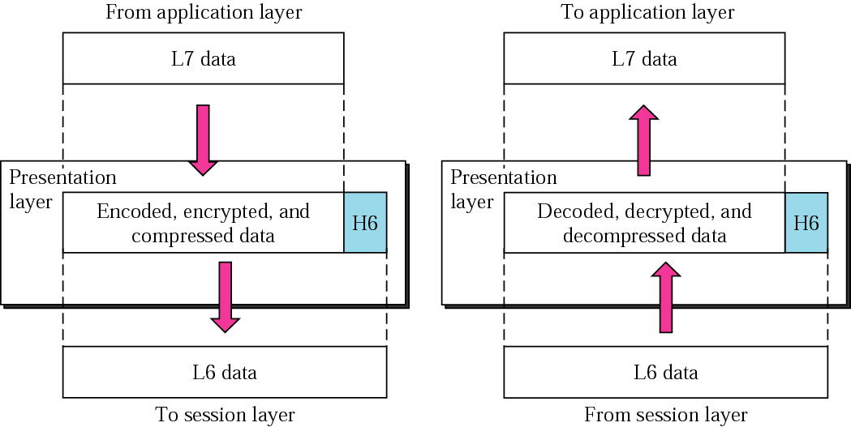
Presentation Layer

Slide 20
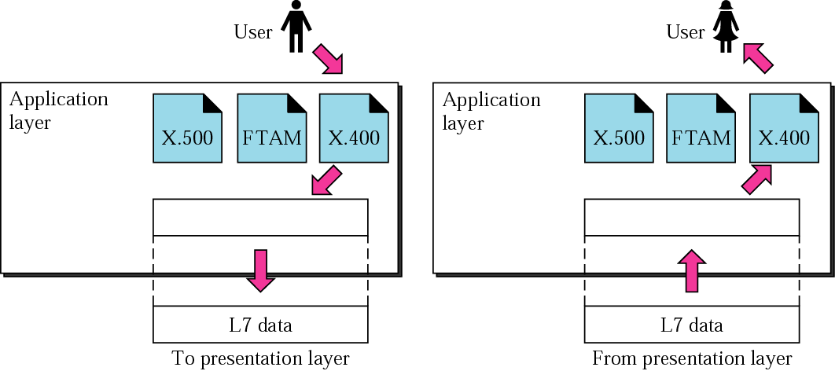
Application Layer

Slide 21
2.3 TCP/IP Protocol Suite
7
Application
Application
The historical and technical open standard of the Internet
Wanted a network that could survive any conditions, even a nuclear war
6
Presentation
5
Session
4
Transport
Transport
3
Network
Internet
2
Data Link
Network
Access
1
Physical
OSI/RM
TCP/IP

Slide 22
TCP/IP协议
FTP
HTTP
SMTP
DNS
DNS
TFTP
SNMP
Socket
TCP
UDP
ICMP
IGMP
IP
ARP
RARP
LANs
MANs
WANs

Slide 23
Multiplexing of TCP/IP Protocols
Telnet
FTP
SMTP
SNMP
TFTP
Port
23
21
25
161
69
TCP
UDP
ICMP
Protocol ID
6
17
1
IP
ARP
Type
0800H
0806H
Ethernet
software
MAC
Ethernet
hardware

Slide 24
2.4 Addressing in TCP/IP
Address
Physical address
物理地址
IP address
IP地址
Port address
端口地址
标识通信节点
节点所属LAN或WAN指定
LAN或WAN内唯一
链路地址/硬件地址
0x0005.5D06.1418
标识通信节点的网络连接
Internet指定
Internet内唯一
网络地址
202.115.12.34
标识通信进程
操作系统指定
一台计算机内唯一
21, 23, 25, 80
8080, 10000

Slide 25
Relation-ship of Layers and Addresses in TCP/IP
Application layer
Process
Port address
Transport layer
TCP
UDP
Network layer
IP and other protocols
IP address
Network Access layer
Underlying physical networks
Physical address

Slide 26
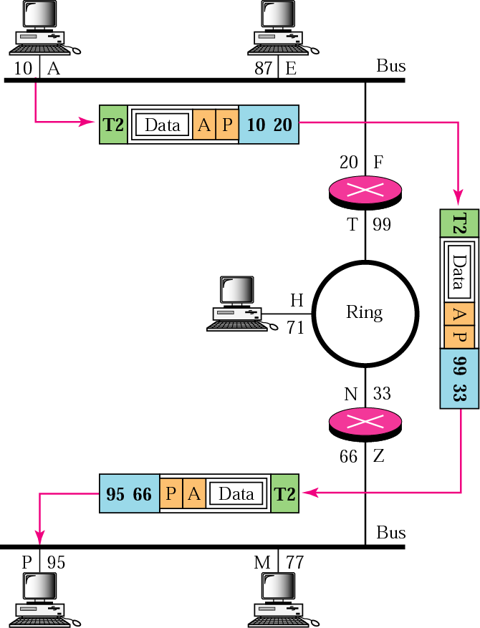
Example 1

Slide 27
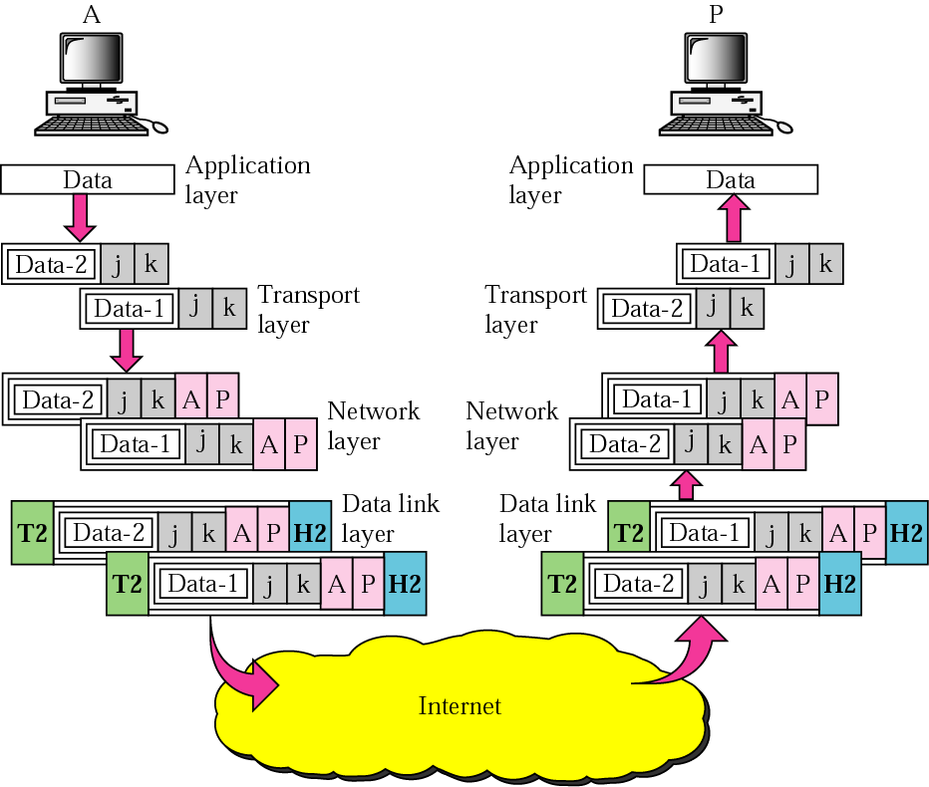
Example 2

Slide 28
2.5 TCP/IP Versions
Version 4（current）
  Insufficient address space: 32-bit
  Inefficient mechanism: poor QoS and security
Version 5
  A proposal on the OSI model
  Never went beyond the proposal stage
Version 6（future）
  Only change network layer protocols: IPv6, ICMPv6
  Large address space：128-bit
  Improve the weakness of version 4

Slide 29
2.6 Summary
对分层网络协议体系的理解
  不同节点：层次组成不同，作用不同
  横向理解：虚通信，对等实体，协议，PDU
  纵向理解：封装与解封，服务，接口
OSI/RM
  作用
  各层的名称和功能（概要描述）
TCP/IP
  层次：与OSI模型的对应关系
  协议：主要协议及其所在层次

Slide 30
Summary（cont.）
Addressing
  物理、IP、端口地址：作用，所在层次
区别
  OSI vs. ISO
  Physical address vs. MAC address
  Network address vs. IP address

